Slide 1
Innovation Course
Ofir Gerbi

Slide 2
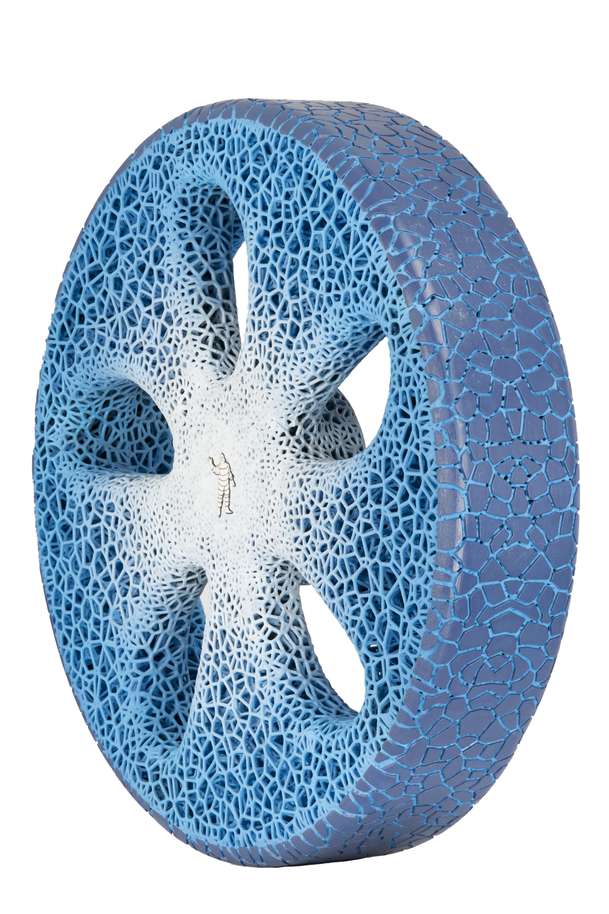
Idea
Disruptive
Strategic Canvas
Six Paths
Business Canvas
PESTEL
A new way for your car tires
Airless
No flat tires
3D printed, customizable
Environment friendly
Less maintenance
Easy to repair

Slide 3

Idea
Disruptive
Strategic Canvas
Six Paths
Business Canvas
PESTEL
A new way for your car tires
Revolutionary and nonlinear
Rare – difficult and risky
Significant technological breakthrough
Requires creativity
Radical

Slide 4
Disruptive
Idea
Strategic Canvas
Six Paths
Business Canvas
PESTEL
Improves performance of established products
Sustaining Technology
Measure Of Performance
Consumers that want and will pay new features/services.
Low-end Distribution
Different Measure Of Performance
New Market
Undershot consumers
Time
Time

Slide 5
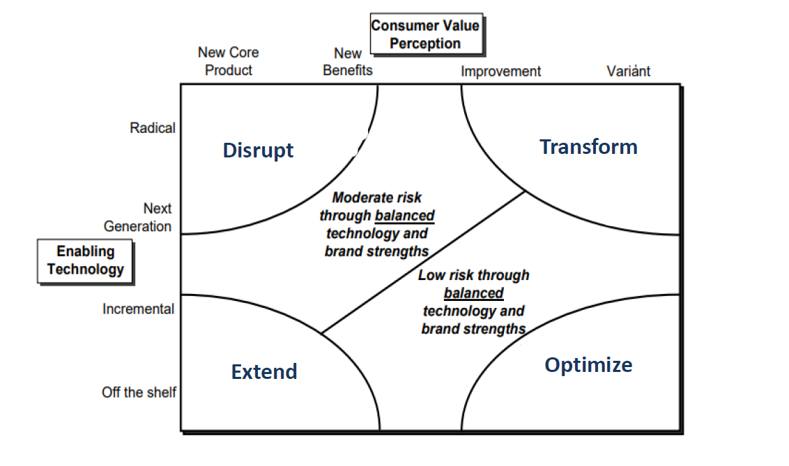
Disruptive
Idea
Strategic Canvas
Six Paths
Business Canvas
PESTEL
Airless
tires

Slide 6
Disruptive
Idea
Strategic Canvas
Six Paths
Business Canvas
PESTEL
High risk
Less historical data
Radical change with new business elements
Expectation for failures
Emphasis on research
Airless
tires

Slide 7
Strategic Canvas
Idea
Disruptive
Six Paths
Business Canvas
PESTEL
High
Offering Level
Low
Safety
Price
Durability
Easy
Maintenance
Environment friendly
Connectivity
Airless tire
Traditional tires

Slide 8
Six Paths
Idea
Disruptive
Strategic Canvas
Business Canvas
PESTEL
Complementary products and services:
Connectivity app with tire status
Industry
Tires industry
Automotive companies
Tire shops
Other tire companies
Strategic groups
Functional and emotional
Better functionality
Environment-friendly
Buyer Groups
Willing to pay for the best product they can get
Environment aware
Sustainable trends
Environment-friendly
Ease of use, less maintenance

Slide 9
Business Canvas
Idea
Disruptive
Strategic Canvas
Six Paths
PESTEL
Key Partners
Key Activities
Value Proposition
Relationships
Segments
Automotive industry
Raw material suppliers
3D printer companies
Car distribution
Manufacturing
Quality control
Marketing and sales
Research
Less maintenance – money saving
No flat tires
Environment friendly
Easy to repair
Tire shops
Customer service
Self service
Car/motorbike owners
Any other wheeled vehicles owners
Automotive industry
Key Resources
Channels
Employees
Facilities
Brand awareness
Buy online
Tire shops
Car shops
Cost Structure
Revenue Streams
Research
Brand awareness
Legal and safety tests
Raw material
Manufacturing costs
Human resources
Asset sale – tires for sell
Subscription fees - connectivity app

Slide 10
Business Canvas
Idea
Disruptive
Strategic Canvas
Six Paths
PESTEL
Key Partners
Key Activities
Value Proposition
Relationships
Segments
Automotive industry
Raw material suppliers
3D printer companies
Car distribution
Manufacturing
Quality control
Marketing and sales
Research
Less maintenance – money saving
No flat tires
Environment friendly
Easy to repair
Tire shops
Customer service
Self service
Car/motorbike owners
Any other wheeled vehicles owners
Automotive industry
Key Resources
Channels
Employees
Facilities
Brand awareness
Buy online
Tire shops
Car shops
Cost Structure
Revenue Streams
Research
Brand awareness
Legal and safety tests
Raw material
Manufacturing costs
Human resources
Asset sale – tires for sell
Subscription fees - connectivity app

Slide 11
PESTEL
Idea
Disruptive
Strategic Canvas
Six Paths
Business Canvas
P
S
E
E
T
L

Slide 12
PESTEL
Idea
Disruptive
Strategic Canvas
Six Paths
Business Canvas
P
E
S
T
E
L
Political
Increasing political focus on climate change.
Possible government tax incentive for green products.

Slide 13
PESTEL
Idea
Disruptive
Strategic Canvas
Six Paths
Business Canvas
P
E
S
T
E
L
Economic
economic growth.
Increasing labor cost.

Slide 14
PESTEL
Idea
Disruptive
Strategic Canvas
Six Paths
Business Canvas
P
E
S
T
E
L
Social
Rising awareness for environment-friendly products
Increasing demand for wheeled transport vehicles

Slide 15
PESTEL
Idea
Disruptive
Strategic Canvas
Six Paths
Business Canvas
P
E
S
T
E
L
Technological
Capable competitors
Technological advancement

Slide 16
PESTEL
Idea
Disruptive
Strategic Canvas
Six Paths
Business Canvas
P
E
S
T
E
L
Environmental
Climate change and awareness
Support from NGO

Slide 17
PESTEL
Idea
Disruptive
Strategic Canvas
Six Paths
Business Canvas
P
E
S
T
E
L
Legal
Safety and legal laws
Copyright and patent laws

Slide 18
PESTEL
Idea
Disruptive
Strategic Canvas
Six Paths
Business Canvas
P
S
E
E
T
L

Slide 19


